Slide 1























Slide 2













































Slide 3




































































Slide 4












































Slide 5
























































Slide 6


























































Slide 7



















































Slide 8












































Slide 9











































Slide 10








Slide 14
Ruth Hurwitz Stability Criterion

Slide 15

































Slide 16





























Slide 17
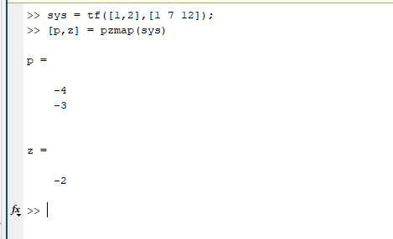









































































Slide 18
















Slide 19
























Slide 20
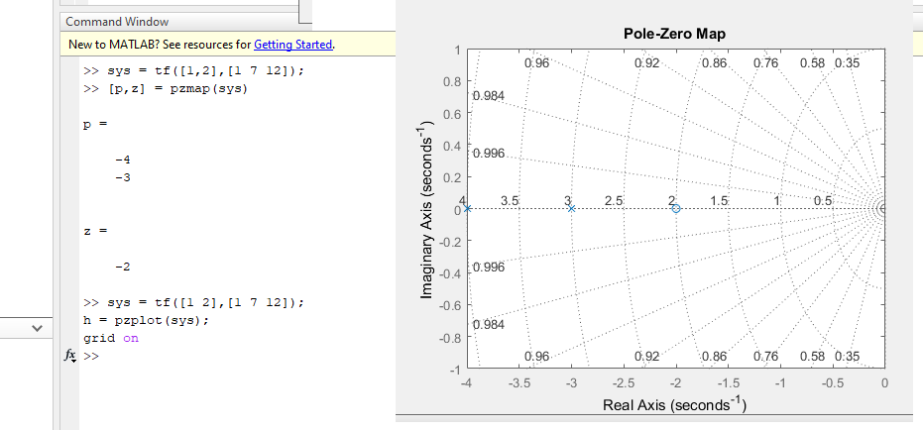









Slide 21




































Slide 22

































Slide 23





















































Slide 24























































Slide 25

















































Slide 26






































Slide 27















































Slide 28





































Slide 29



















































